Slide 1
Transient Conduction:
Finite-Difference Equations and
Solutions
Chapter 5
Section 5.9
 
 

Slide 2

Finite-Difference Method
The Finite-Difference Method
An approximate method for determining temperatures at discrete (nodal) points
of the physical system and at discrete times during the transient process.
Procedure:
  Represent the physical system by a nodal network, with an m, n notation used
  to designate the location of discrete points in the network,
  and discretize the
  problem in time by designating a time increment ∆t and expressing the time
  as t = p∆t, where p assumes integer values, (p = 0, 1, 2,…).
  Use the energy balance method to obtain a finite-difference equation for
  each node of unknown temperature.
Solve the resulting set of equations for the nodal temperatures at
t = ∆t, 2∆t, 3∆t, …, until steady-state is reached.
What is represented by the temperature, ?

Slide 3

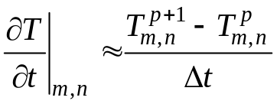
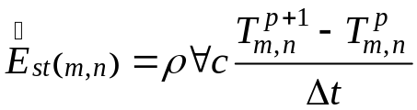
Storage Term
Energy Balance and Finite-Difference
Approximation for the Storage Term
For any nodal region, the energy balance is
(5.76)
where, according to convention, all heat flow is assumed to be into the region.
Discretization of temperature variation with time:
(5.69)
Finite-difference form of the storage term:
Existence of two options for the time at which all other terms in the energy
balance are evaluated: p or p+1.

Slide 4
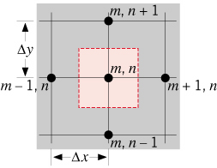
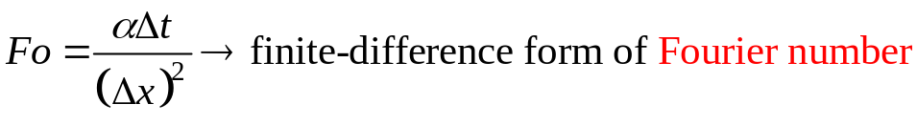
Explicit Method
The Explicit Method of Solution
All other terms in the energy balance are evaluated at the preceding time
corresponding to p. Equation (5.69) is then termed a forward-difference
approximation.
Example: Two-dimensional conduction
for an interior node with ∆x=∆y.
(5.71)
Unknown nodal temperatures at the new time, t = (p+1)∆t, are determined
exclusively by known nodal temperatures at the preceding time, t = p∆t, hence
the term explicit solution.

Slide 5
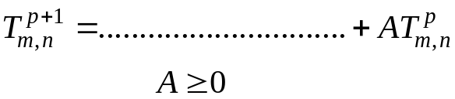


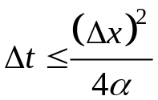
Explicit Method (cont.)
How is solution accuracy affected by the choice of ∆x and ∆t?
Do other factors influence the choice of ∆t?
What is the nature of an unstable solution?
Stability criterion: Determined by requiring the coefficient for the node of interest
at the previous time to be greater than or equal to zero.
For a finite-difference equation of the form,
Hence, for the two-dimensional interior node:
Table 5.2 finite-difference equations for other common nodal regions.

Slide 6
Implicit Method
The Implicit Method of Solution
All other terms in the energy balance are evaluated at the new time corresponding
to p+1. Equation (5.69) is then termed a
backward-difference approximation.
Example: Two-dimensional conduction for
an interior node with ∆x=∆y.
(5.87)
System of N finite-difference equations for N unknown nodal temperatures
may be solved by matrix inversion or Gauss-Seidel iteration.
Solution is unconditionally stable.
Table 5.2 finite-difference equations for other common nodal regions.

Slide 7
Marching Solution
Marching Solution
Transient temperature distribution is determined by a marching solution,
beginning with known initial conditions.
p t T₁ T₂ T_{3………………..} T_{N}
0 0 T_{1,i} T_{2,i} T_{3,i……………….} T_{N,i}
Known
1 ∆t -- -- -- …………… --
2 2∆t -- -- -- …………… --
3∆t -- -- -- …………… --
. .
. .
. .
. .
. .
. .
Steady-state -- -- -- -- ……………. --

Slide 8
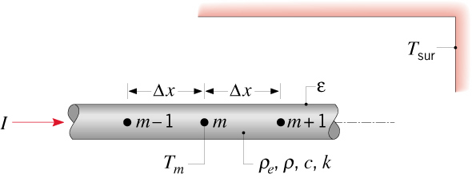
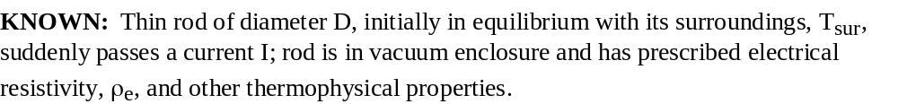
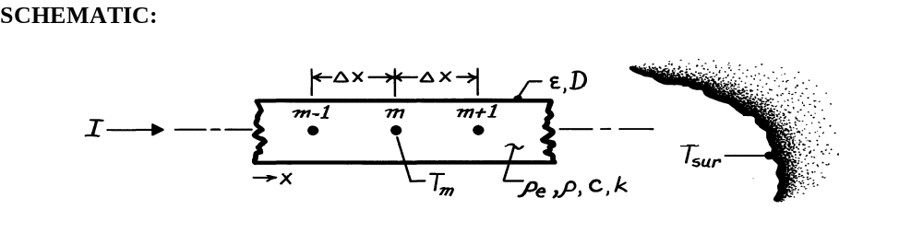
Problem: Finite-Difference Equation
Problem 5.94: Derivation of explicit form of finite-difference equation
for a nodal point in a thin, electrically conducting rod
confined by a vacuum enclosure.

Slide 9

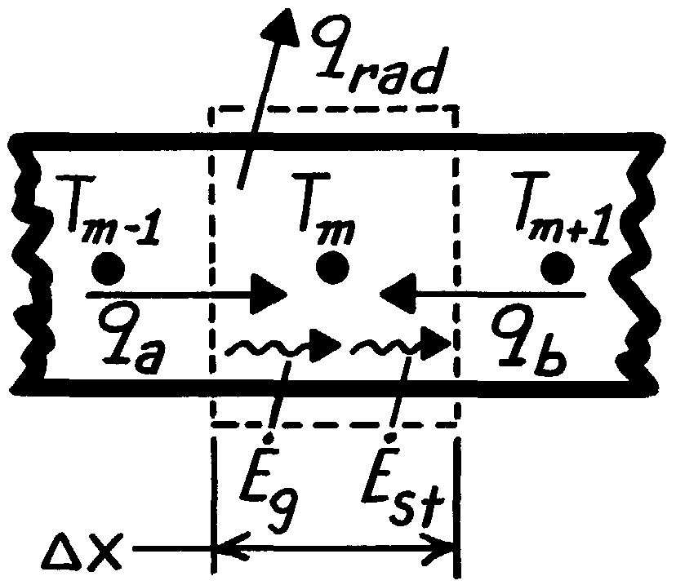
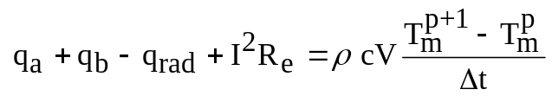
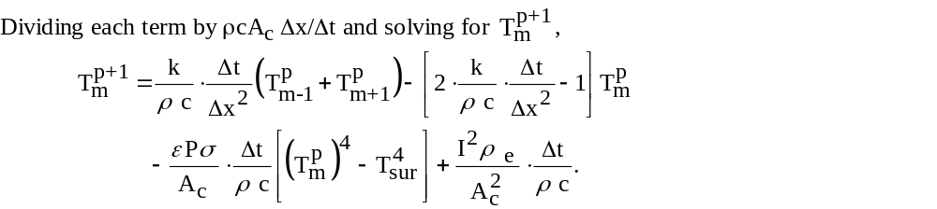
Problem: Finite-Difference Equation

Slide 10
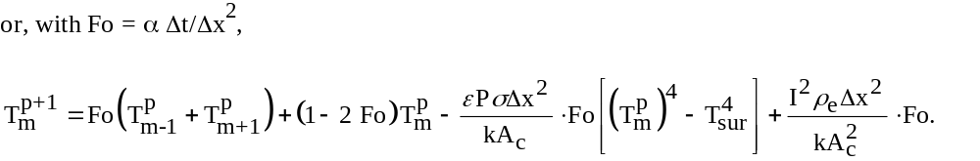
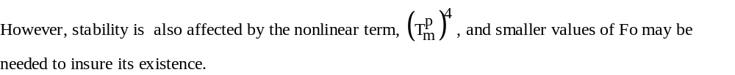
Problem: Finite-Difference Equation

Slide 11
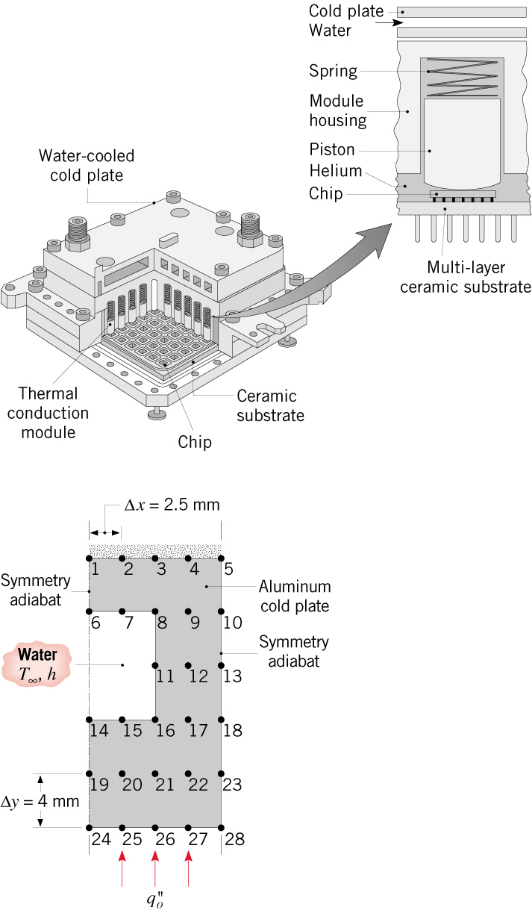




Problem: Cold Plate
Problem 5.127: Use of implicit finite-difference
method with a time interval of
∆t = 0.1s to determine transient
response of a water-cooled cold
plate attached to IBM multi-chip
thermal conduction module.
Features:
Cold plate is at a uniform temperature,
T_{i}=15°C, when a uniform heat flux
of is applied to its base
due to activation of chips.
During the transient process, heat
transfer into the cold plate increases
its thermal energy while providing for
heat transfer by convection to the
water . Steady state is reached
when .

Slide 12
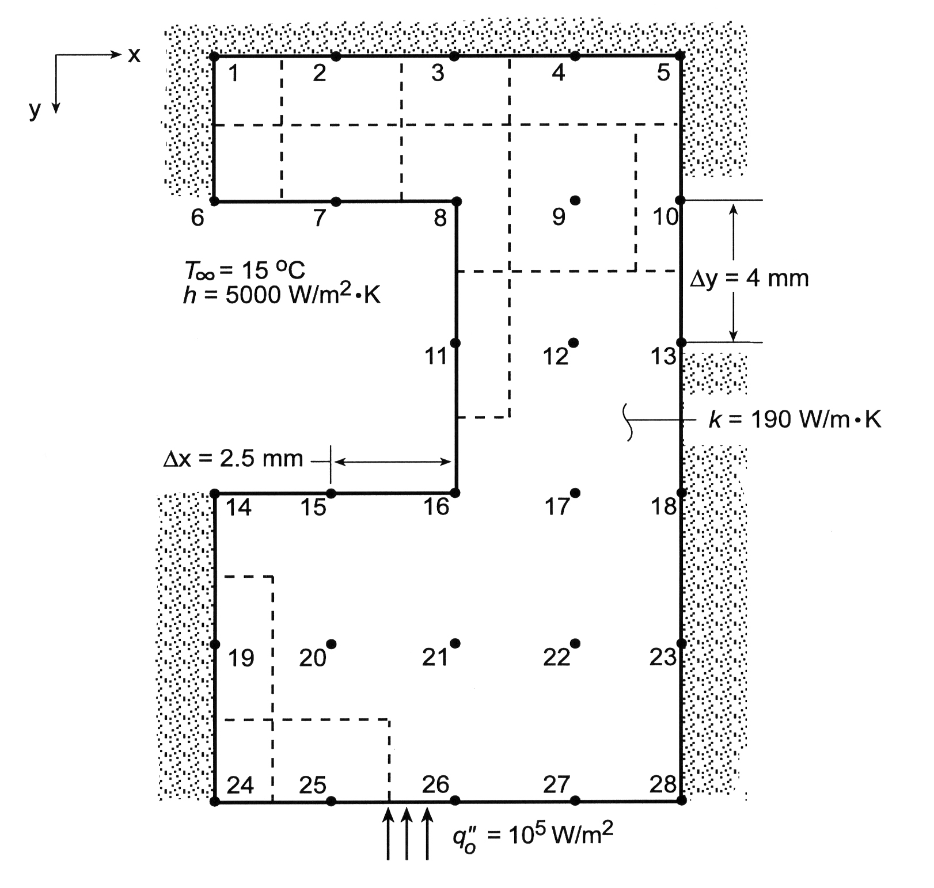
Problem: Cold Plate (cont.)

Slide 13
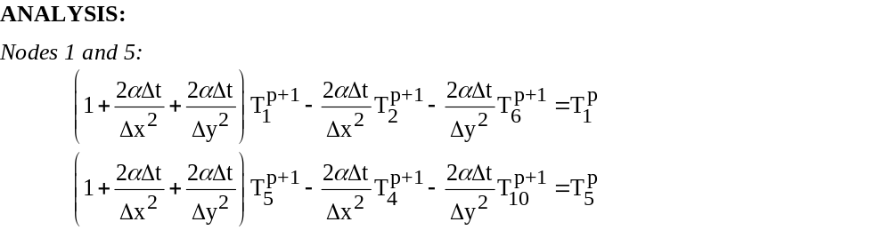
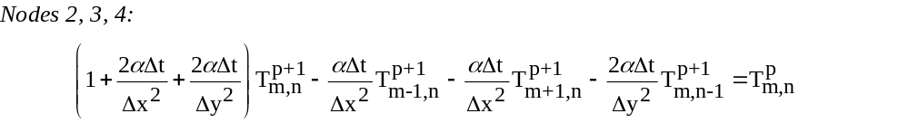
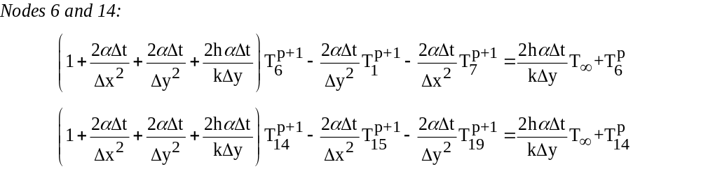
Problem: Cold Plate (cont.)

Slide 14
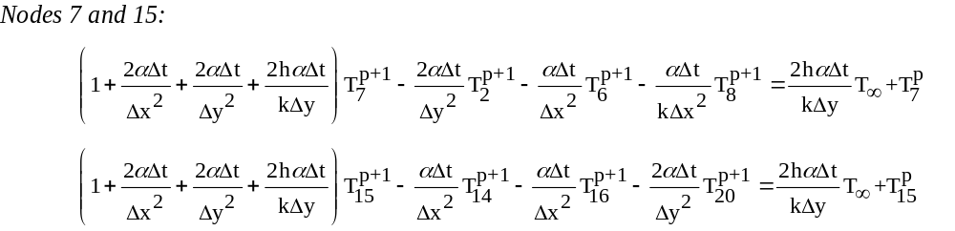
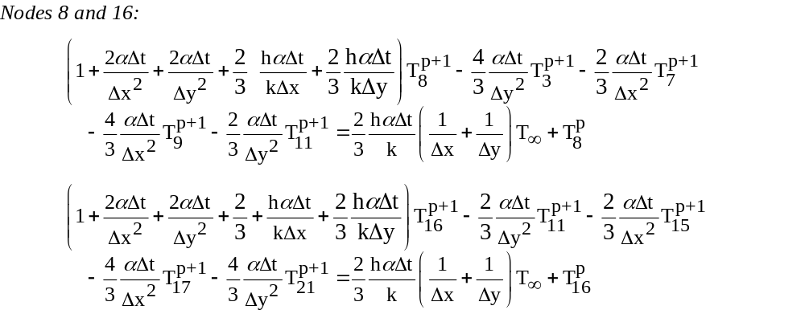
Problem: Cold Plate (cont.)

Slide 15
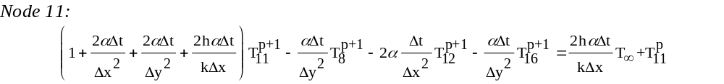
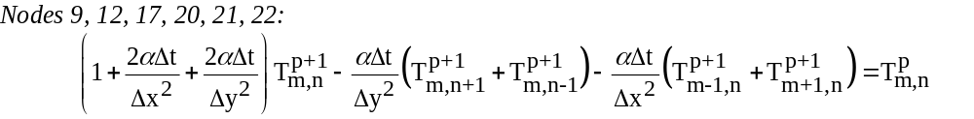
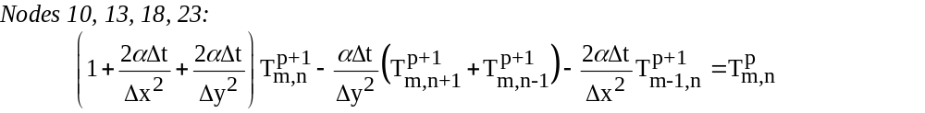
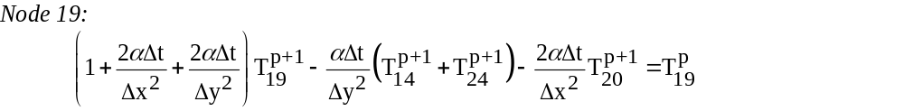
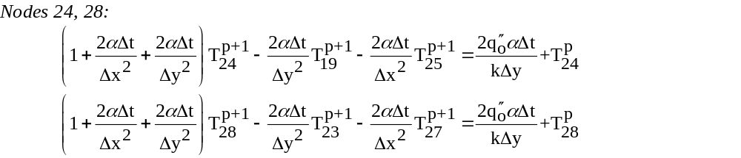
Problem: Cold Plate (cont.)

Slide 16
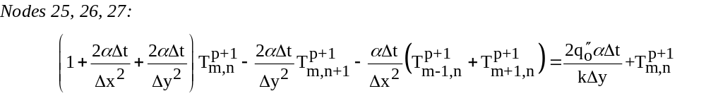
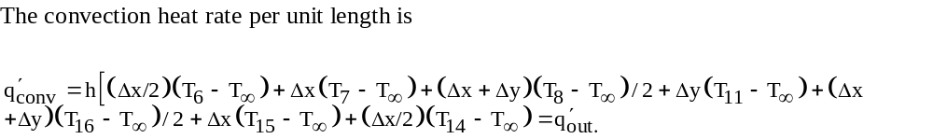
Problem: Cold Plate (cont.)

Slide 17
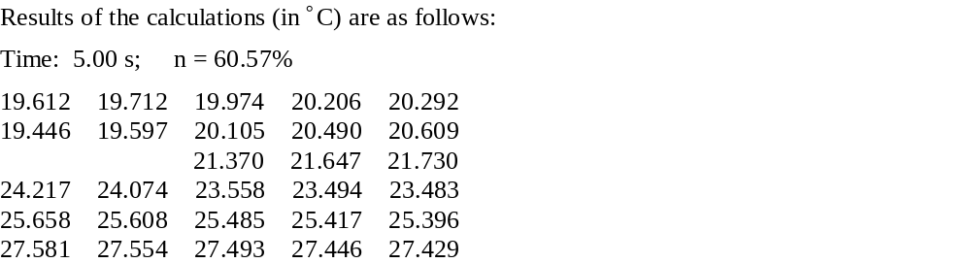
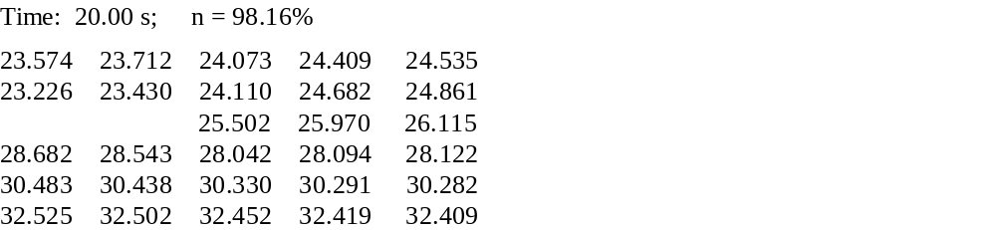
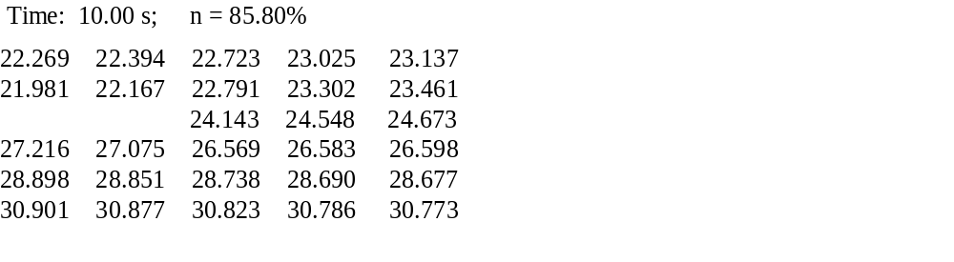
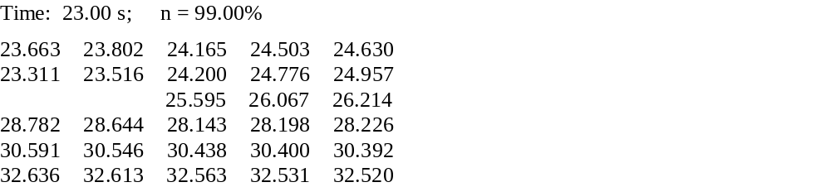
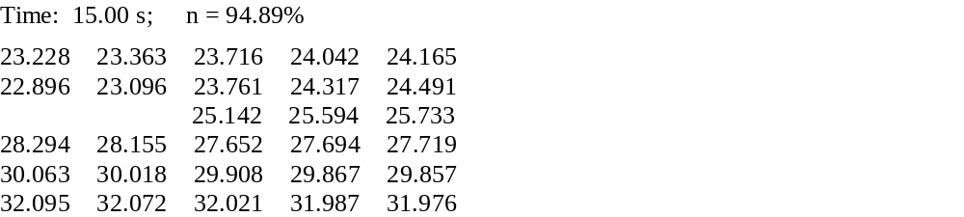
Problem: Cold Plate (cont.)

